Slide 1
Entity-Relationship (ER)
Data Model
Elmasri & Navathe (Chapter 7and 8)

Slide 2
Database Design Process
Mini World
REQUIREMENTS COLLECTION AND ANALYSIS
Functional Requirements
Database requirements
FUNCTIONAL ANALYSIS
CONCEPTUAL DESIGN
High-level Transaction Specification
Conceptual Schema
(in a high-level data model)
DBMS independent
LOGICAL DESIGN
(DATA MODEL MAPPING)
DBMS specific
Logical (Conceptual) Schema
(in the data model of specific DBMS)
APPLICATION PROGRAM DESIGN
PHYSICAL DESIGN
TRANSACTION IMPLEMENTATION
Application Programs
Internal Schema (For the same DBMS)

Slide 3
Phases of Database Design
Requirements collection and analysis
Database Requirements
Functional Requirements (operations on database)
Conceptual Design & Functional Analysis
Create a conceptual schema
High level transaction specification corresponding to operations on database
Logical Design
Map conceptual database schema to implementation database schema
Physical Design
Internal storage structures and file organizations are specified
Application Program Design & Transaction Implementation (in parallel to physical design)

Slide 4
ER modeling tools
Erwin
MySQL Workbench.
TerraER (opensource)
http://www.terraer.com.br/index_en.html

Slide 5
Entity Relationship Model
Attribute
Attribute Name
Course_Name
Department
Faculty_Name
Credit_hours
Course_No
Faculty
Teaches
Course
Entity Name
Entity
Relationship Name
Entity Name
Relationship
Entity

Slide 6
Example: COMPANY Database
Requirements for the Company Database
The company is organized into Departments. Each department has a name, number, and an employee who manages the department. We keep track of the start date if the department has a manager. A department may have several locations.
Each department controls a number of Projects. Each project has a name, number, and is located at a single location.

Slide 7
Example: COMPANY Database
Requirements for the Company Database
We store each Employee’s social security number, name, addresses, salary, sex (gender), and birth date. Each employee works for one department but may work on several projects. We keep track of the number of hours per week that an employee currently works on each project. We also keep track of the direct supervisor of each employee.
Each employee may have a number of Dependents. For each dependent, we keep their name, sex, birthdate, and relationship to the employee.
Check last two slides for the ER Model for Company Database

Slide 8
ER Model
ER model describes data as:
Entities
Relationships
Attributes

Slide 9
Entities and Attributes
Entities are specific objects or things in the mini world that are represented in the database; for example the Employee John Smith, the Research Department, the Database Project.
Attributes are properties used to describe an entity; for example, an Employee entity may have a Name, ID, Address, Sex (Gender), BirthDate.
A specific entity will have a value for each of its attributes.

Slide 10
Value Sets (or domain of values)
Specifies set of values that may be assigned to an attribute for each individual entity

Slide 11
Entities and Attributes
Name=John Smith
Name=Sunco Oil
Address=2311,Kirby,
Houston Texas
e1
c1
Headquaters=Houston
Age=55
Home Phone=713 749263o
President=John Smith

Slide 12
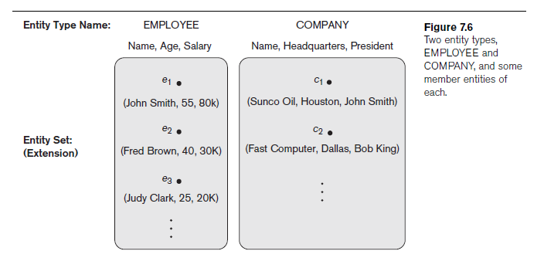
Entity Types
Entities with the same basic attributes are grouped or typed into an entity type. For example, the Employee entity type or the Company entity type.

Slide 13
Key Attributes
An attribute of an entity type for which each entity must have a unique value is called a key attribute of the entity type. For example VehicleID of Car Entity
A key attribute can be composite. For example Registration(Registration Number, State) of Car.

Slide 14
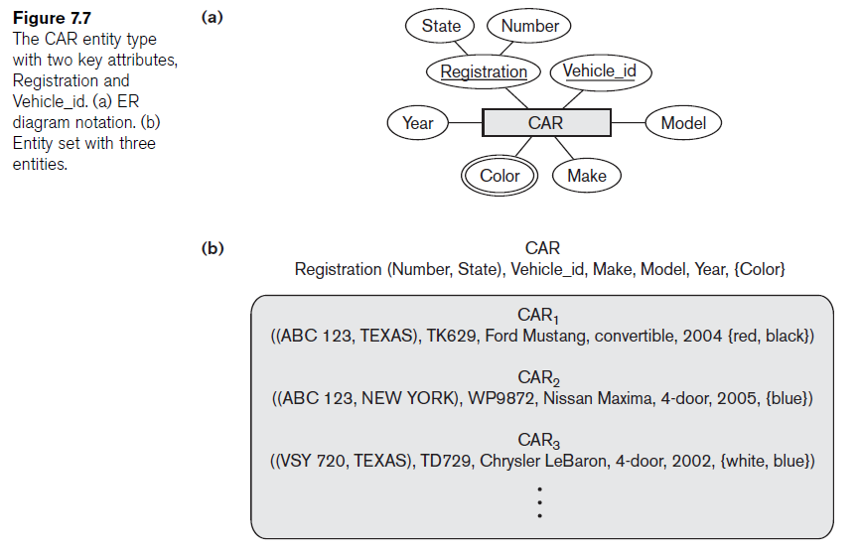
Car Entity Type
A key attribute can be composite. For example Registration(Registration Number, State) of Car.
An entity type may have more than one key. For example VehicleID and Registration(Registration Number, State) of Car.

Slide 15
Types of Attributes
Composite versus simple (atomic) attributes
Single-valued versus multivalued attributes
Stored versus derived attributes
NULL values
Complex attributes

Slide 16
Types of Attributes
Simple: Each entity has a single atomic value for the attribute. For example ID, CourseNo.
Composite: The attribute may be composed of several components. For example Address, StreetAddress.
Address
StreetAddress
City
State
Zip
Number
Street
ApartmentNumber

Slide 17
Types of Attributes
Multivalued: An entity may have multiple values for that attribute. For example, Color of a Car or PreviousDegrees of a Ph.D. Student.
Derived: The domain value of attribute can be determined from one or more other attributes. For example, age from birth date, SGA from course grades.
In general, composite and multiple-valued attributes may be nested arbitrarily to any number of levels although this is rare.

Slide 18
NULL values
Not Applicable: NULL is presented when a particular entity may not have an applicable value for an attribute.
Examples:
the Apartment_number attribute of an address applies only to addresses that are in apartment buildings and not to other types of residences, such as single-family homes.
A College_degrees attribute applies only to people with college degrees.
Unknown: NULL can also be used if we do not know the value of an attribute for a particular entity
Example - The home phone number of ‘John Smith’ in not known.
The unknown category of NULL can be further classified into two cases. The first case arises when it is known that the attribute value exists but is missing—for instance, if the Height attribute of a person is listed as NULL. The second case arises when it is not known whether the attribute value exists (?)—for example, if the Home_phone attribute of a person is NULL.

Slide 19
Complex Attribute
Composite and multivalued attributes can be nested arbitrarily
{Address_phone({Phone(Area_code, Phone_number)},Address(Street_address (Number, Street, Apartment_number), City, State,Zip) )}

Slide 20
Visualizing Entity Types & Attributes
Minit
Fname
Lname
Salary
Address
Name
Age
EMPLOYEE
SSN
Bdate

Slide 21
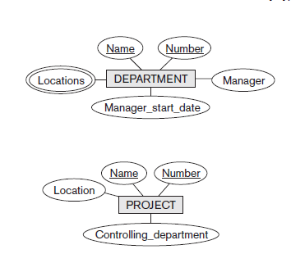
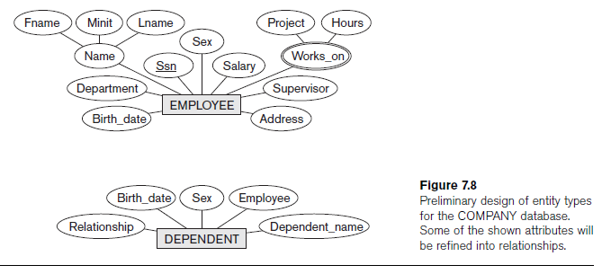
Initial Conceptual Design of the
COMPANY Database

Slide 22
Relationships and Relationship Types
A Relationship relates two or more distinct entities with a specific meaning.
Example:
Employee John Smith works on the Database Project, or
Employee Jim Wong manages the Research Department.
Relationships of the same type are grouped or typed into a relationship type.
Example:
The Works_On relationship type in which Employee’s and Project's participate.

Slide 23
Relationship Types
Employee
WORKS_ON
Project
e1
r1
p1
e2
p2
r2
e3
p3
r3
e4
p4
r4
e5
p5
r5
r6
r7

Slide 24
Relationship type and instances
Relationship type R among n entity types E1, E2, ..., En
Defines a set of associations among entities from these entity types
Relationship instances ri
Each ri associates n individual entities (e1, e2, ..., en)
Each entity ej in ri is a member of entity set Ej

Slide 25
Attributes for Relationship type
A relationship type can have attributes; for e.g., HoursPerWeek of Works_On; its value for each relationship instance describes the number of hours per week that an Employee works on a Project

Slide 26
Degree of a Relationship Type
The degree of a relationship type is the number of participating entity types.
Binary, Ternary, …….
Works_On is a binary relationship.
More than one relationship type can exist with same participating entity types. For e.g., Manages & Works_For.

Slide 27
Relationship Types - Roles
Roles of distinct entity types in a relationship are not necessary. But are required if the same entity type participates in the relationship. For example, a Supervision relationship type relates one Employee (in the role of Subordinate) to another Employee (in the role of supervisor). This is called a recursive relationship type.
Employee
SUPERVISION
e1
2
r1
1 - Supervisor Role
2- Subordinate Role
e2
2
1
2
1
r2
e3
1
r3
e4
2
1
r4
e5
1
e6
2
1
r5
e7
r6
2
e8
r7

Slide 28
Visualizing of Relationship Types
Fname
Minit
Lname
Salary
Address
Name
Age
EMPLOYEE
SSN
Bdate
Locations
StartDate
SUPERVISOR
SUPERVISEE
Number
Name
SUPERVISION
MANAGES
DEPARTMENT

Slide 29
Structural Constraints
Cardinality ratio (of a binary relationship)
1:1 for binary relationship type E1:E2, each entity of entity type E1 can be related to an entity of entity type E2, and each entity of entity type E2 can be related to an entity of entity type E1. For example, MANAGES between EMPLOYEE and DEPARTMENT.
1:N for binary relationship type E1:E2, each entity of entity type E1 can be related to numerous entities of entity type E2, and each entity of entity type E2 can be related to an entity of entity type E1. For example, WORKS_FOR between DEPARTMENT and EMPLOYEE.
M:N for binary relationship type E1:E2, each entity of entity type E1 can be related to numerous entities of entity type E2, and each entity of entity type E2 can be related numerous entities of entity type E1. For example, WORKS_ON between PROJECT and EMPLOYEE.

Slide 30
Relationship Types
One to One
Many to One
One to Many
Many to Many

Slide 31
Structural Constraints
Participation constraint whether the existence of an entity depends on its being related to another entity via the relationship type.
Total participation (existence dependency)
every entity in “the total set” of entities must be related to other entities via a relationship. For example, Employee WORKS_FOR Department.
Partial Participation - some or “part of the set of” entities are related to other entities via a relationship. For example, Employee MANAGES Department.

Slide 32
Visualizing of Structural Constraints
M
N
WORKS_ON
PROJECT
EMPLOYEE
N
WORKS_FOR
1
1
MANAGES
1
DEPARTMENT

Slide 33
Notation for Structural Constraints
For 1:1 Relationship type R, place 1 on either side of the relationship type R.
For 1:N Relationship type between E1 and E2 (i.e., E1:E2), place N on the edge between E1 and R, and 1 between E2 and R.
For M:N Relationship type R, place M and N on either side of relationship type R.
For total participation of E1 in a relationship type R, make the edge between E1 and R double line.

Slide 34
Alternate Notation for Structural Constraints
Alternate (min, max) Notation:
Specified on each participation of an entity type E in a relationship type R
Specifies that each entity e in E participates in at least min and at most max relationship instances in R.
Default (no constraint): min = 0, max = n.
Must have min <= max, min >= 0, max >=1.
Derived from mini-world constraints

Slide 35
Structural Constraints Examples
A department has exactly one manager and an employee can manage at most one department.
Specify (1,1) for participation of Department in Manages
Specify (0,1) for participation of Employee in Manages
An employee must work in exactly one department but a department can have any number of employees
Specify (1,1) for participation of Employee in Works_For
Specify (0,n) for participation of Department in Works_For

Slide 36
Relationship Types as Attributes
In some cases one can represent a relationship type as an attribute of an entity type
A 1:1 relationship type can be replaced by an single valued attribute in any of the participating entity types.
A 1:n relationship type can be replaced by an single valued attribute in the “n” side entity type, but require multivalued attribute in the “1” side entity type.
But for m:n relationship type we have to use multivalued attribute in both the entity types (for a binary relationship type).
Relationships are represented by attributes in functional and object-oriented data models.

Slide 37
Weak Entity Types
An entity type that does not have a key attribute
A weak entity type must participate in an identifying relationship type with an owner or identifying entity type
Always has a total participation constraint
Entities are identified by the combination of:
A partial key of the weak entity type
The particular entity they are related to in the identifying entity type
Example: Suppose that a Dependent entity is identified by the dependent’s first name and birthdate, and the specific Employee that the dependent is related to. Dependent is a weak entity type with Employee as its identifying entity type via the identifying relationship type DEPENDENTS_OF.

Slide 38
Visualizing of Weak Entity Types
Fname
Minit
Lname
Salary
Address
Name
Age
EMPLOYEE
SSN
BDate
Relationship
DEPENDENTS_OF
Name
Sex
BDate
DEPENDENT

Slide 39
Relationships with higher degree
Relationship types of degree 2 are called binary
Relationship types of degree three are called ternary and of degree n are called n-ary
In general, an n-ary relationship is not equivalent to n binary relationships.
Example
TAUGHT_DURING
Semester
Year
IName
Sem_Year
INSTRUCTOR
OFFERS
SEMESTER
CAN_TEACH
OFFERED_DURING
CNumber
COURSE

Slide 40
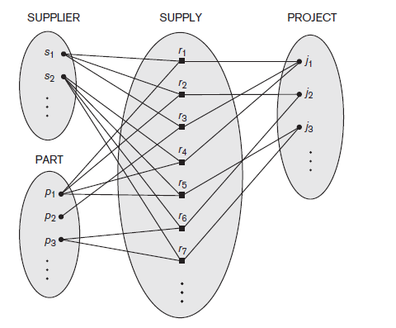
Relationships with higher Degree
(a)
SName
ProjName
Quantity
SUPPLIER
SUPPLY
PROJECT
PartNo
PART
Above ternary relationship models the fact that a supplier supplies a part (attribute quantity denoting number of parts) to a project .

Slide 41
Relationships with higher Degree
SName
ProjName
M
N
(b)
SUPPLIER
SUPPLIES
PROJECT
M
M
CAN_SUPPLY
PartNo
USES
PART
N
N
The above ER model shows three binary relationship
types, namely, Supplies between Supplier and Project,
Uses between Part and Project, and Can_Supply between
Part and Supplier.
This is not the same as the ternary relationship type Supply
shown in the previous page.

Slide 42
Relationships with higher Degree
(c)
SName
Quantity
ProjName
I
SS
N
SUPPLY
N
SPJ
I
SUPPLIER
PROJECT
N
SP
PartNo
I
PART
The above ER model shows how the original ternary relationship type can be modeled by using three binary relationship types.
This is done by making original “Supply” relationship type
a weak entity with three identifying entity types Supplier,
Project and Part. And the corresponding identifying relationship
types, SS, SPJ, and SP.

Slide 43
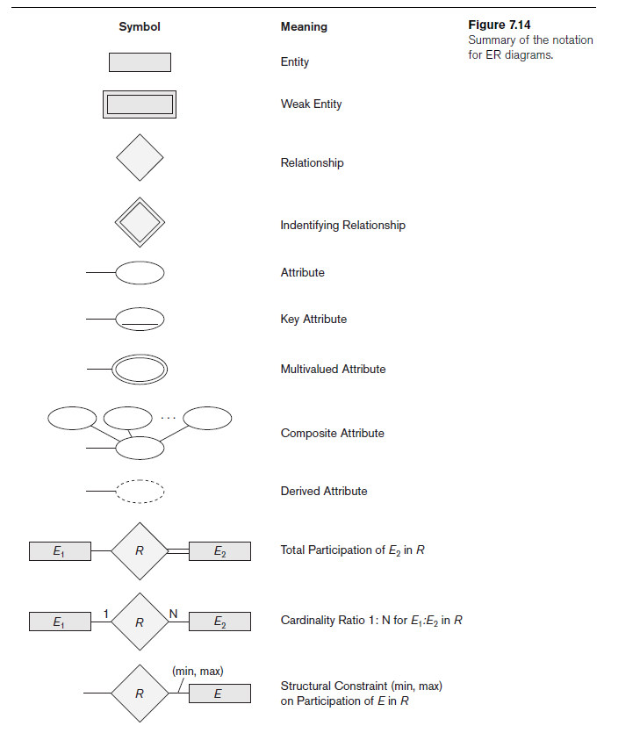
ER-diagram Notation

Slide 44
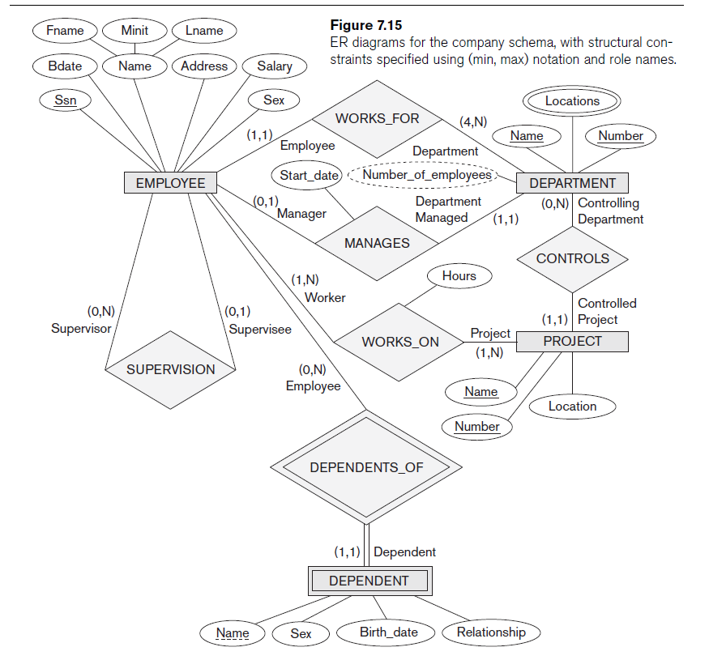
ER Diagram with Role Names and Structural Constraints
Company database

Slide 45
Enhanced ER Model
Subclasses, Superclasses, and Inheritance
Specialization
Generalization
Aggregation

Slide 46
Specialization
Specialization is the process of defining a set of subclasses of an entity type (called the superclass of specialization) – support for “is-a” relationship
For example set of subclasses {secretary, engineer, technician} of super class employee
Salary
Name
EMPLOYEE
SSN
d
EngrType
Education
Secretary
Technician
Engineer
Tgrade

Slide 47
Generalization
Suppress differences of different entity types, identify their common attributes, and generalize them into a super class
Price
Number
Vid
Vehicle
Tonnage
Passengers
Axles
d
Speed
Truck
Car

Slide 48
Constraints on Specialization & Generalization
Disjoint, Total
Disjoint, Partial
Overlapping, Total
Overlapping, Partial

Slide 49
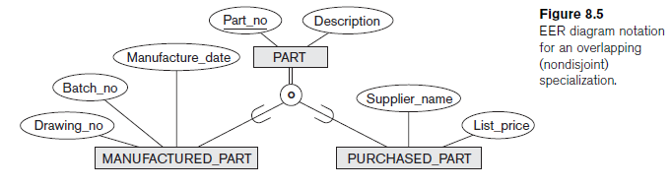
Overlapping

Slide 50
Aggregation
Aggregation is an abstraction concept for building composite objects from their component objects
Support for “is part of” relationship

Slide 51
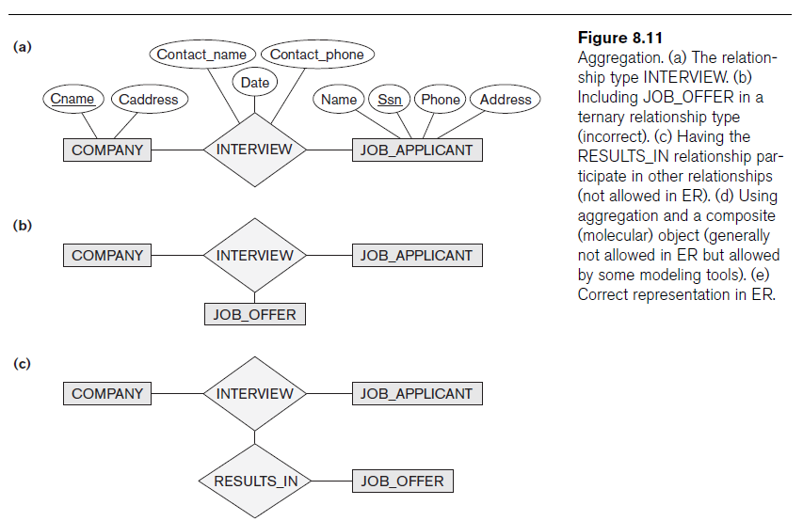
Aggregation

Slide 52
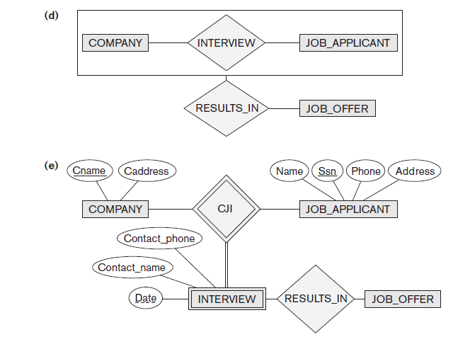
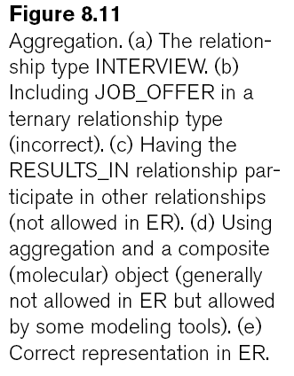
Aggregation

Slide 53
Modeling of UNION Types Using Categories
Union type or a category
Represents a single superclass/subclass relationship with more than one superclass
Subclass represents a collection of objects that is a subset of the UNION of distinct entity types
Attribute inheritance works more selectively
Category can be total or partial
Some modeling methodologies do not have union types

Slide 54
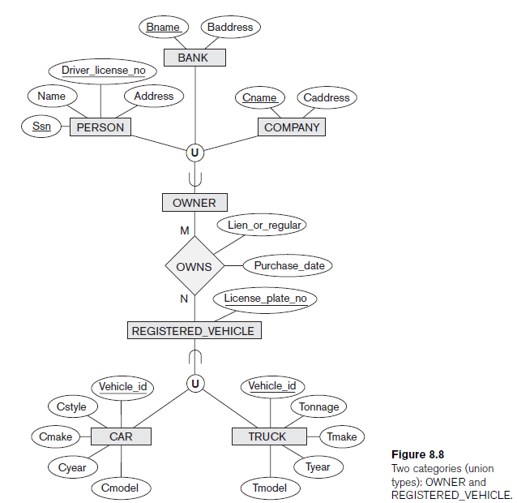
Union Type

Slide 55
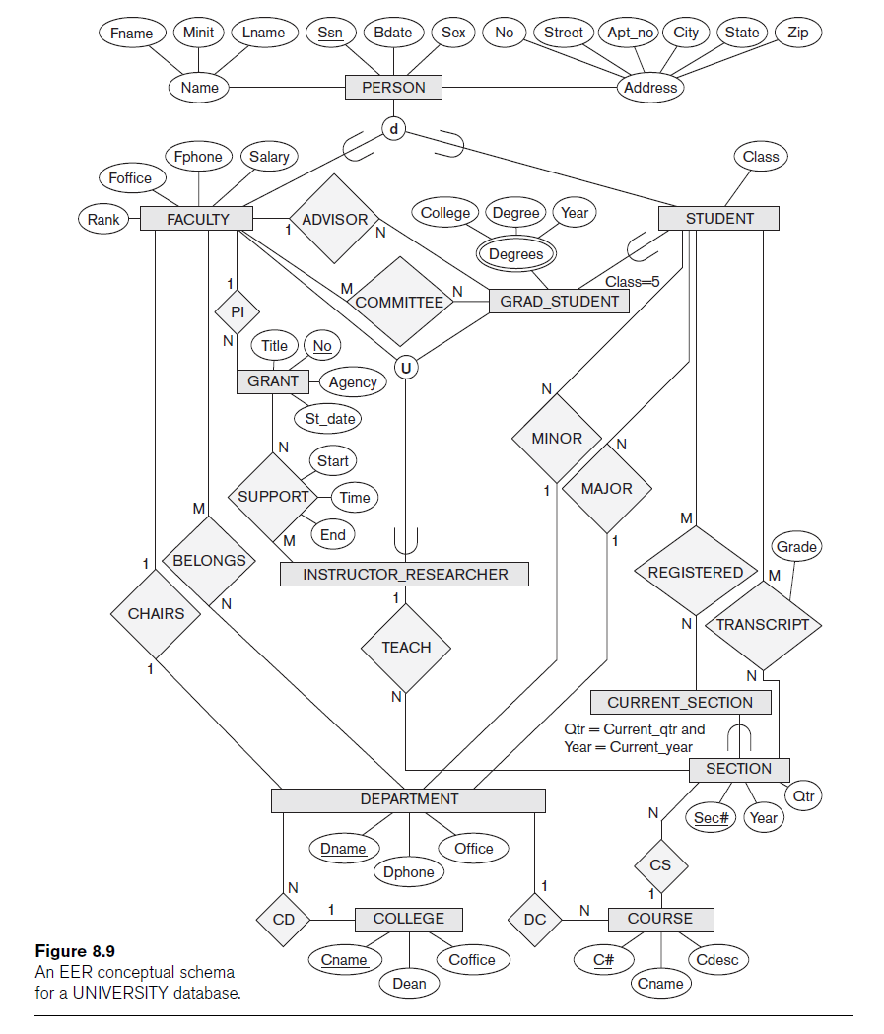

Slide 56
Data Abstraction & Knowledge Representation
Apply abstraction process to identify common properties – while disregarding insignificant differences
Provide concepts, constraints, operations, and languages for defining data and representing knowledge
KR broader than data models
KR includes reasoning mechanisms

Slide 57
Abstraction Concepts in SDMs & KR
Classification and Instantiation
Define object classes – ‘IS-AN-INSTANCE-OF’
Identification
Classes and objects are made uniquely identifiable
To distinguish among database objects and classes and relate database objects to their real-world counterparts

Slide 58
Abstraction Concepts in SDMs & KR
Specialization & Generalization
Aggregation & Association
Aggregation builds composite/complex objects – models ‘IS-PART-OF’
Association relates objects from independent classes – models ‘IS-ASSOCIATED-WITH’

Slide 59
Ontology & Semantic Web
Ontology
Is similar to a conceptual schema, but with more knowledge, rules, and exceptions
‘Specification of Conceptualization’ – includes both specification & conceptualization
Semantic Web
Attempts to create knowledge representation models to allow meaningful information exchange and search among machines

Slide 60
Examples of Ontology
Thesaurus – dictionary – glossary: describes relationships between words that represent various concepts
Taxonomy: how concepts of particular area of knowledge are related using structure similar to specialization & generalization
Database Schema
Logic theory: propositional logic – predicate calculus, frames, etc.

